Slide 1



DISSERTATION - Ⅱ / AV5411 / REVIEW - Ⅰ
Department of Aerospace Engineering
Division of Avionics
DESIGN OF LQR CONTROLLER FOR QUADCOPTER
Presented by
Karukkuvel Raj D (2022603003) M.E (Avionics)
Under the Guidance of
Dr.Anitha G
Professor,
Division of Avionics,
Dept of Aerospace Engineering.

Slide 2
Introduction
Unmanned Aerial Vehicles (UAVs) have gained significant attention for their versatile applications in various fields, with their autonomous capabilities, UAVs navigate through airspace without direct human intervention
Quadcopters exhibit complex dynamics influenced by multiple factors such as motor thrust, inertia, and aerodynamics.
Motion in six degrees of freedom (roll, pitch, yaw, and translational motion) requires sophisticated control strategies.
Precise control is vital for stability, maneuvering, and achieving desired flight trajectories.

Slide 3
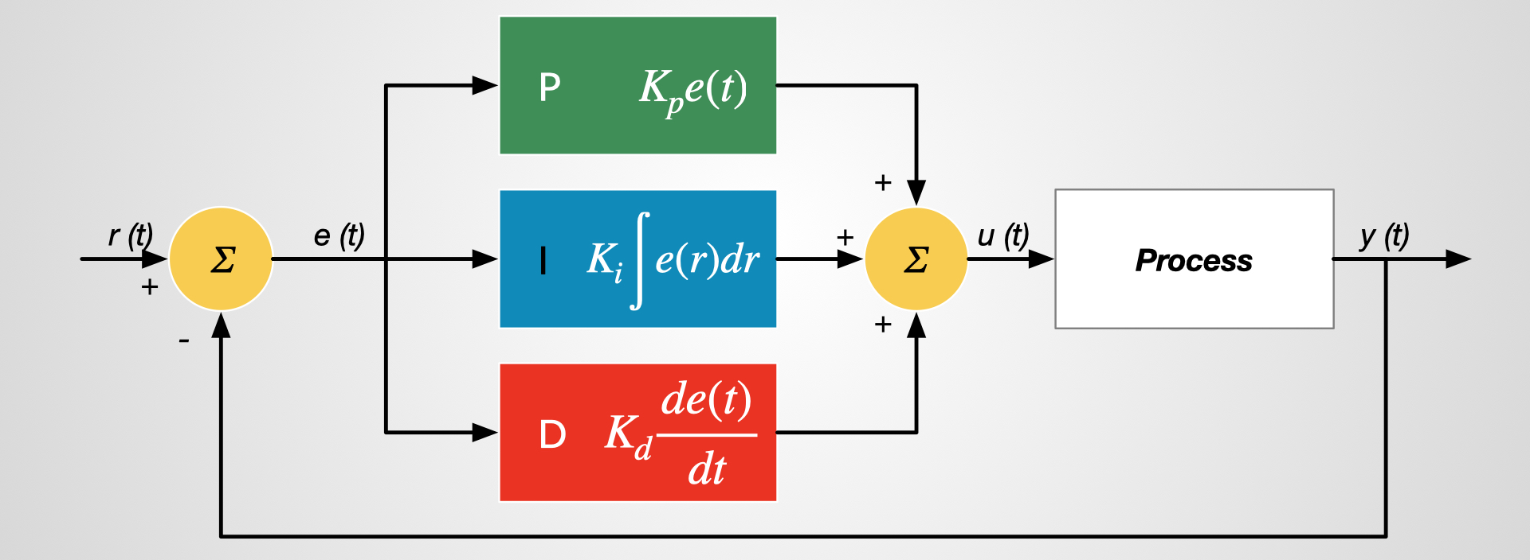
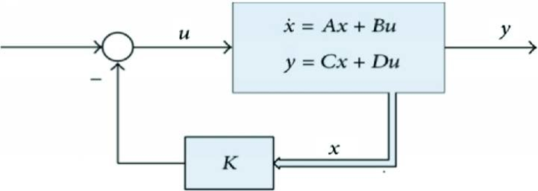
Controllers used in Quadcopter
PID
LQR

Slide 4
Controllers used in Quadcopter
PID
LQR
PID controllers provide a simple yet effective method for stabilizing and controlling quadcopter motion.
They adjust control inputs based on the error between desired and actual states, considering proportional, integral, and derivative terms.
While PID controllers are straightforward to implement and tune, they may struggle with complex dynamics and nonlinearities compared to more advanced techniques like LQR.
Nevertheless, PID controllers remain a popular choice for quadcopter control due to their simplicity and versatility.
Linear Quadratic Regulator (LQR) is a control technique used to optimize the performance of linear dynamic systems.
LQR designs a feedback controller that minimizes a quadratic cost function, balancing control effort and system performance.
It provides robust control by considering both state feedback and control effort constraints.

Slide 5
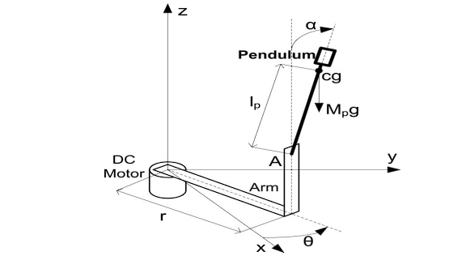
Why LQR?
In “Performance Study of PID Controller and LQR Technique for Inverted Pendulum” by Akhil Jose, Clint Augustine, Shinu Mohanan Malola, Keerthi Chacko they had taken a rotary inverted pendulum model.

Slide 6
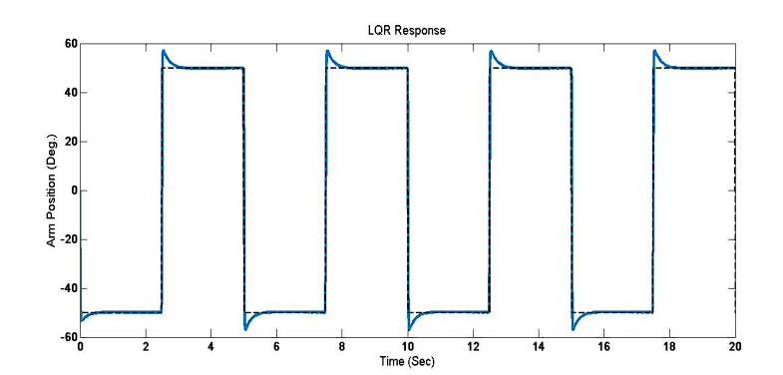
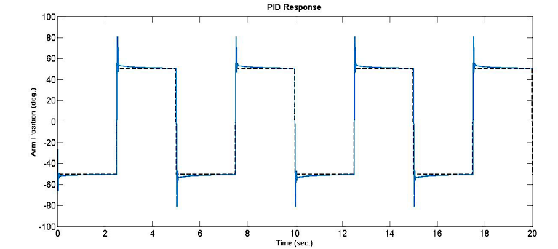
Why LQR?
In “Performance Study of PID Controller and LQR Technique for Inverted Pendulum” by Akhil Jose, Clint Augustine, Shinu Mohanan Malola, Keerthi Chacko they had taken a rotary inverted pendulum model.
There is a considerable reduction in overshoot and settling time with the LQR controller, when compared with the PID controller. The response is more stable and robust

Slide 7
Problem Statement
Despite the effectiveness of PID controllers, they often face limitations in handling nonlinearities and disturbances inherent in quadcopter dynamics.
- Quadcopters operating in real-world environments encounter uncertainties such as wind gusts, payload variations, and changes in battery voltage, challenging the stability and performance of PID control.
- The need for robust and adaptive control strategies becomes crucial to address these challenges and enhance the reliability and agility of quadcopter systems.
- Therefore, there is a demand for advanced control techniques like LQR to overcome the shortcomings of PID controllers and optimize quadcopter performance in various operating conditions.

Slide 8
Objective
To design a LQR controller for a quadcopter model, implement it in real-time hardware and compare the performance with the existing PID controller

Slide 9
Workflow:
Literature Review
Modelling of Quadcopter
Design of LQR controller
Validation of Controller by SITL
Realtime flight using the designed LQR controller

Slide 10
Literature Review
S.No | Author | Title | Journal/Year | Description
1 | Aisha Sir Elkhatem, Seref Naci Engin | Robust LQR and LQR-PI control strategies based on adaptive weighting matrix selection for a UAV position and attitude tracking control | Alexandria Engineering Journal (2021) | The novel method for adjusting weighting matrices in Linear Quadratic Regulator (LQR) control, utilizing the quadrotor's state variables matrix and a designer-determined preference factor, effectively compensates for model deficiencies against disturbances. Both LQR and LQR with a Proportional-Integral (PI) controller demonstrate improved performance and robustness in stabilizing the quadrotor's position and attitude. Robustness is measured by introducing mass variations, angle perturbations, and reducing actuator effectiveness, all of which the control strategies effectively mitigate. Overall, this method enhances the adaptability of LQR and LQR with a PI controller, making them more suitable for real-world applications with uncertainties and disturbances.

Slide 11
Literature Review
S.No | Author | Title | Journal/Year | Description
2 | Alessandro Minervini; Simone Godio, S.M.ASCE; Giorgio Guglieri, Ph.D.; Fabio Dovis, Ph.D.; and Alfredo Bic | Development and Validation of a LQR-Based Quadcopter Control Dynamics Simulation Model | International Journal of Aerospace Engineering 2021 | A simulation model of a quadcopter is developed and validated by the comparison of simulation results and experimental data collected during flight tests. For this purpose, an open-source flight controller for quadcopter UAVs is developed and a linear quadratic regulator (LQR) controller is implemented as the control strategy. The input physical quantities are experimentally measured; hence, the LQR controller parameters are tuned on the simulation model. The same tuning is proposed on the developed flight controller with satisfactory results. Finally, flight data and simulation results are compared showing a reliable approximation of the experimental data by the model.

Slide 12
Literature Review
S.No | Author | Title | Journal/Year | Description
3 | Zaid Tahir, Mohsin Jamil, Saad Ali Liaqat, Lubva Mubarak | Design and Development of Optimal Control system for QuadCopter UAV | International Journal of Aerospace Engineering 2021 | Optimal control techniques (LQR & LQG) were studied and implemented in MATLAB Simulink using the 6DOF quad copter state space models. The simulations produced satisfactory results. By changing the weights of Q and R weighing matrices in our LQR controller we optimized our energy consumption. Implementation of Kalman filter in our LQG controller showed us how important it is when noise is added to the overall system as it is in the real physical world. The implementation of optimal control on the actual 6DOF setup was understood, but not undertaken in this phase.
4 | Oktaf Agni Dhewa, Andi Dharmawa, Tri Kuntoro Priyambodo | Model of Linear Quadratic Regulator (LQR) Control Method in Hovering State of Quadrotor | Journal of Telecommunication, Electronic and Computer Engineering (JTEC) (2017) | Quadcopter is built and flown using a custom M4 controller and LQR controller is designed for hovering state and LQR controller is implemented for all the three axes (pitch, roll and yaw) and the quad is flown successfully.

Slide 13
Literature Review
S.No | Author | Title | Journal/Year | Description
5 | Fendy Santoso , Member, IEEE, Matthew A. Garratt, Member, IEEE, Sreenatha G. Anavatti, and Ian Petersen, Fellow, IEEE | Robust Hybrid Nonlinear Control Systems for the Dynamics of a Quadcopter Drone | IEEE TRANSACTIONS ON SYSTEMS, MAN, AND CYBERNETICS: SYSTEMS (2018) | This paper addresses the problem of accurate trajectory tracking of a small quadcopter unmanned aerial vehicle in the face of uncertainties. a hybrid feedback and feedforward autopilot that has the capability to eliminate the cross-coupling disturbance between the lateral and the longitudinal loops with respect to the vertical loop as well as external disturbances. A MPC based controller along with fuzzy feed-forward compensator is used. Robustness analyses is done in two parts: 1. for fuzzy feedforward compensator, they used sum of square of error 2. MPC is analysed by relaxing its constraint, so they can do linear approximation. From that they chose a optimal horizon and tested it for external disturbances. Also a robustness analysis is done by doing a multiplicative uncertainty

Slide 14
Literature Review
S.No | Author | Title | Journal/Year | Description
6 | MohamedOkasha , Jordan Kralev and Maidul Islam | Design and Experimental Comparison of PID, LQR and MPC Stabilizing Controllers for Parrot Mambo Mini-Drone | Aerospace (MDPI) 2022 | PID, LQR and MPC controllers for Parrot Mini Drone is developed, and the tracking performance of each controller is analysed by simulation, foundout PID performance is oscillatory, but LQR and MPC performances are same. And after that it is put it in actual controller with the help of Matlab coder and the experiments results show that PID works in only one axis (i.e suitable to SISO) whereas LQR performed better than due to MPC by hardware limitations. , environmental factors may greatly affect the quadrotor’s performance in that case where the controllers have limited opportunity to show their robustness. Thus, the system shows inconsistency in both simulated and experimental results.

Slide 15
Literature Review
S.No | Author | Title | Journal/Year | Description
7 | Mohamad Norherman SHAUQEE, Parvathy RAJENDRAN, Nurulasikin Mohd SUHADIS | Quadrotor Controller Design Techniques and Applications Review | INCAS BULLETIN 13 2021 | Three different categories of flight controllers that are being used for controlling the quadrotor. These controllers can be categorized as 1) linear control, 2) nonlinear control, and 3) intelligent control. It shows that out of 80 controller design techniques used, 72.5% of the researchers conducted a simulation study, and about only 3.75% performed experimental studies on a real quadrotor platform. In contrast, 23.75% of the researchers performed both simulation and experimental studies to validate the simulation results. In some cases, they found that the simulation outcome sometimes completely differs from the experimental result due to either simplification made to the quadrotor dynamics or an unexpected external disturbance present in the real application that is not being accounted in the simulation process.

Slide 16

Model of Quadrotor:
From [2] we have got the mathematical model for the Quadrotor which is given below:
$x=w[\sin{ϕ}\sin{ψ+\cos{ϕ}\cos{ψ}}\sin{θ]−v[cos{ϕ}}\sin{ψ−\sin{ϕ\cos{ψ\sin{θ}]+u [\cos{ψ\cos{θ}]}}}}$
$y=v\left[\cos{ϕ\cos{ψ}}+\sin{ϕ}\sin{ψ}\sin{θ}\right]−w\left[\cos{ψ}\sin{ϕ}−\cos{ϕ}\sin{ψ}\sin{θ}\right]+u[\cos{θ}\sin{ψ]}$
$z=w\left[\cos{ϕ}\cos{θ}\right]−u\sin{θ}+v[\cos{θ}\sin{ϕ}$]
$Φ=p+r\left[\cos{ϕ}\tan{θ}\right]+q[\sin{ϕ}\tan{θ}]$
$θ=q\cos{ϕ}−r\sin{ϕ}$
$ψ=r\frac{\cos{ϕ}}{\cos{θ}}+q\frac{\sin{ϕ}}{\cos{θ}}$
$u=rv−qw−g\sin{θ}$
$v=pw+ru+g\sin{ϕ}\cos{θ}$
$w=qu−pv+g\cos{θ}\cos{ϕ}−F_{T}$
$p=\frac{I_{y}−I_{z}}{I_{x}}rq+\frac{4n_{T}L\sin{θ}∆{PWM}_{x}}{I_{x}}$
$q=\frac{I_{z}−I_{x}}{I_{y}}pr+\frac{4n_{T}L\cos{θ}∆{PWM}_{y}}{I_{y}}$
$r=\frac{I_{x}−I_{y}}{I_{z}}pq+\frac{4n_{c}∆{PWM}_{z}}{I_{z}}$

Slide 17

Model of Quadrotor:
From Linearising that we get state matrix as follows
0 | 0 | 0 | 0 | 0 | 0 | 1 | 0 | 0 | 0 | 0 | 0
0 | 0 | 0 | 0 | 0 | 0 | 0 | 1 | 0 | 0 | 0 | 0
0 | 0 | 0 | 0 | 0 | 0 | 0 | 0 | 1 | 0 | 0 | 0
0 | 0 | 0 | 0 | 0 | 0 | 0 | 0 | 0 | 1 | 0 | 0
0 | 0 | 0 | 0 | 0 | 0 | 0 | 0 | 0 | 0 | 1 | 0
0 | 0 | 0 | 0 | 0 | 0 | 0 | 0 | 0 | 0 | 0 | 1
0 | 0 | 0 | 0 | -g | 0 | 0 | 0 | 0 | 0 | 0 | 0
0 | 0 | 0 | g | 0 | 0 | 0 | 0 | 0 | 0 | 0 | 0
0 | 0 | 0 | 0 | 0 | 0 | 0 | 0 | 0 | 0 | 0 | 0
0 | 0 | 0 | 0 | 0 | 0 | 0 | 0 | 0 | 0 | 0 | 0
0 | 0 | 0 | 0 | 0 | 0 | 0 | 0 | 0 | 0 | 0 | 0
0 | 0 | 0 | 0 | 0 | 0 | 0 | 0 | 0 | 0 | 0 | 0
$A=$

Slide 18
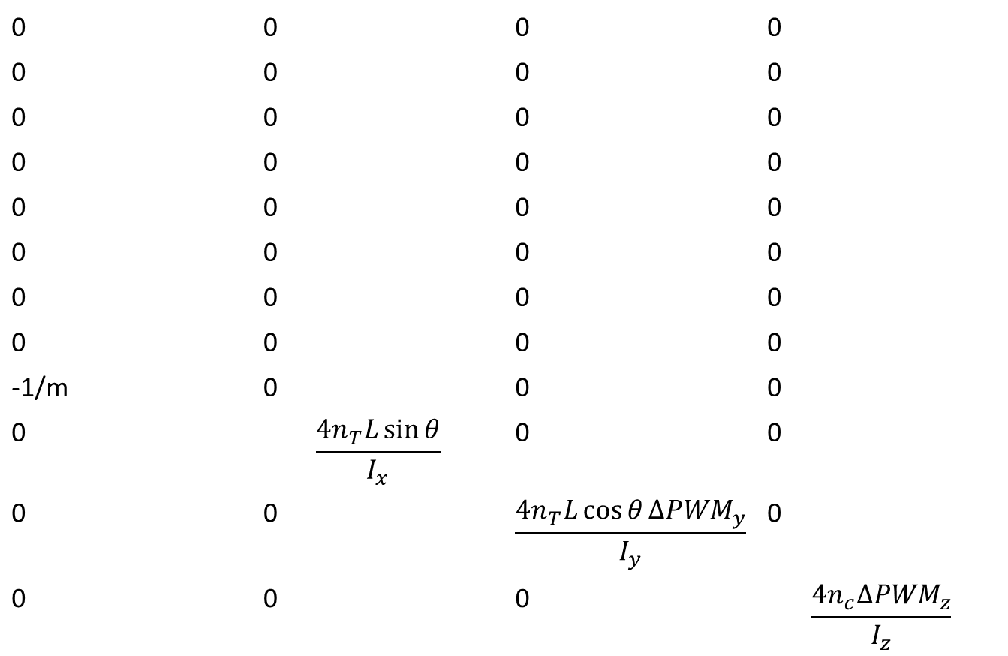

Model of Quadrotor:
From Linearising that we get actuator matrix as follows
0 | 0 | 0 | 0
0 | 0 | 0 | 0
0 | 0 | 0 | 0
0 | 0 | 0 | 0
0 | 0 | 0 | 0
0 | 0 | 0 | 0
0 | 0 | 0 | 0
0 | 0 | 0 | 0
-1/m | 0 | 0 | 0
0 | $$\frac{4n_{T}L\sin{θ}}{I_{x}}$$ | 0 | 0
0 | 0 | $$\frac{4n_{T}L\cos{θ}∆{PWM}_{y}}{I_{y}}$$ | 0
0 | 0 | 0 | $$\frac{4n_{c}∆{PWM}_{z}}{I_{z}}$$
$B=$

Slide 19
Model of Quadrotor:
F450 frame quadrotor is going to be used :
For That we have Mass Moment of Inertia values are as follows:
Mx = 0.0190 kg m^2
My = 0.0190 kg m^2
Mz = 0.0252 kg m^2
Mass of the Vehicle = 1.1 kg

Slide 20
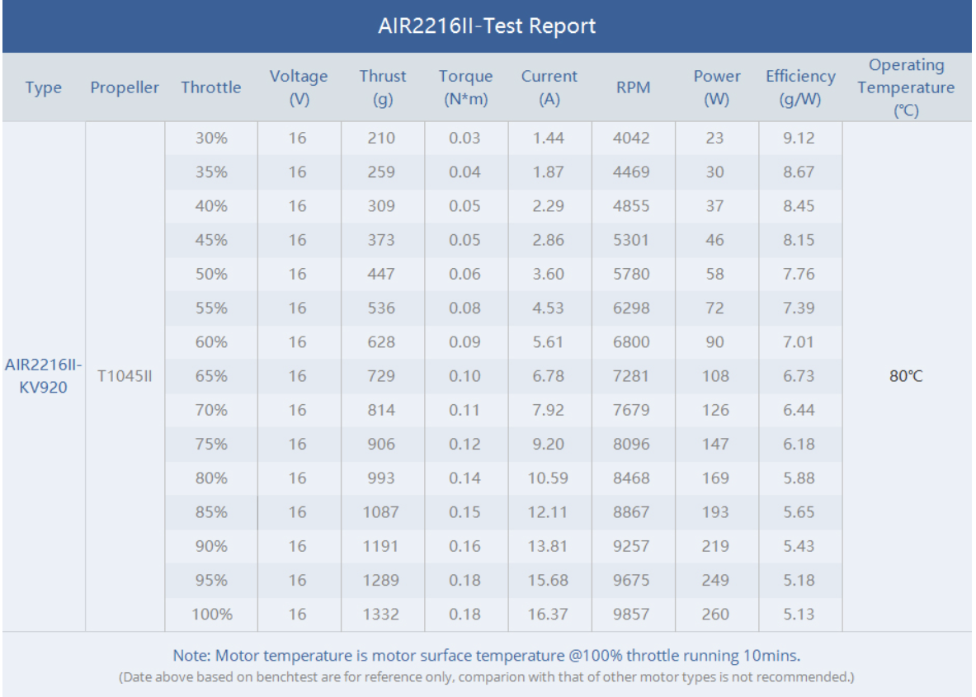
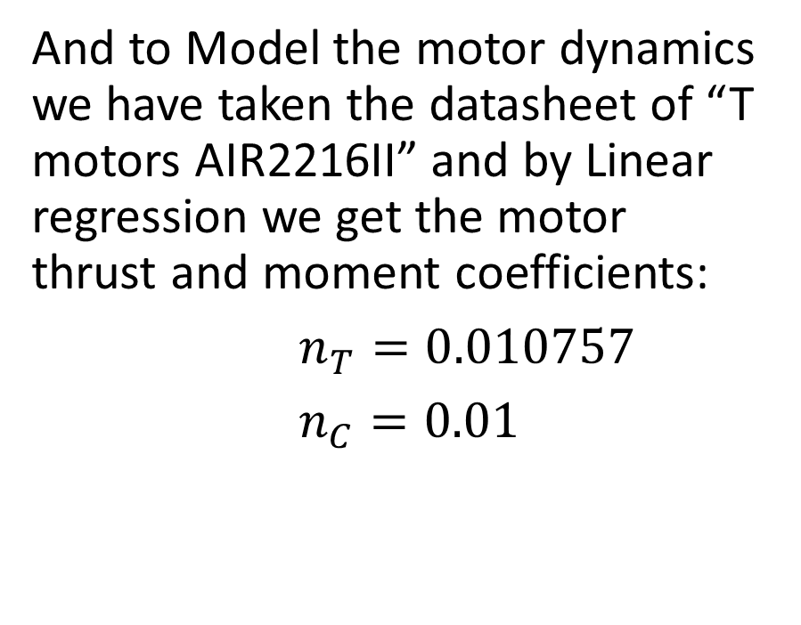
Model of Quadrotor:
And to Model the motor dynamics we have taken the datasheet of “T motors AIR2216II” and by Linear regression we get the motor thrust and moment coefficients:
$n_{T}=0.010757$
$n_{C}=0.01$

Slide 21
Reference:
And to Model the motor dynamics we have taken the datasheet of “T motors AIR2216II” and by Linear regression we get the motor thrust and moment coefficients:
$n_{T}=0.010757$
$n_{C}=0.01$

Slide 22
Thank You

